Slide 1
Context-Free Language

Slide 2
Context-Free Grammars (CFG)
There are languages, such as {0^{n}1^{n} | n ≥ 0} that cannot be described (specified) by finite automata or regular expressions.
Context-free grammars provide a more powerful mechanism for language specification.
Context-free grammars can describe features that have a recursive structure making them useful beyond finite automata.

Slide 3
Formal Definition of a CFG
A context-free grammar is a 4-tuple (V, Σ, R, S) where:
1. V is a finite set of symbols called the variables or nonterminals.
2. Σ is a finite set of symbols, disjoint from V , called terminals.
3. R is a finite set of rules (or specification rules) of the form lhs → rhs, where lhs ∈ V , rhs ∈ (V ∪ Σ).
4. S ∈ V is the start variable.

Slide 4
Example
CFG G1 has the following specification rules:
A → 0A1 |B
B → #
Nonterminals of CFG G1 are {A, B} and A is the start symbol.
Terminals of CFG G1 are {0, 1,#}.

Slide 5
Language specification
A grammar is used for a language specification by generating each string of the language in following manner:
1. Write down the start variable; it is the lhs of the first specification rules, unless specified otherwise.
2. Find a variable that is written down and a rule whose lhs is that variable. Replace the written down variable with the rhs of that rule.
3. Repeat step 2 until no variables remain in the string thus generated
Note: The sequence of substitutions used to obtain a string using a CFG is called a derivation and may be represented by a tree called a derivation tree or a parse tree.

Slide 6
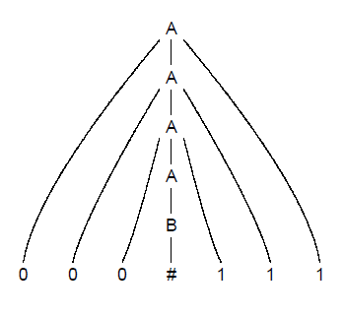
Example derivation tree
The derivation tree of the string 000#111 using G1 is

Slide 7
Context-Free Language, CFL
All strings of terminals generated in this way constitute the language specified by the grammar
We write L(G) for the language generated by the grammar G. Thus, L(G1) = {0^{n}#1^{n} | n ≥ 0}.
A language generated by a context-free grammar (CFG) is called a Context-Free Language, CFL.

Slide 8
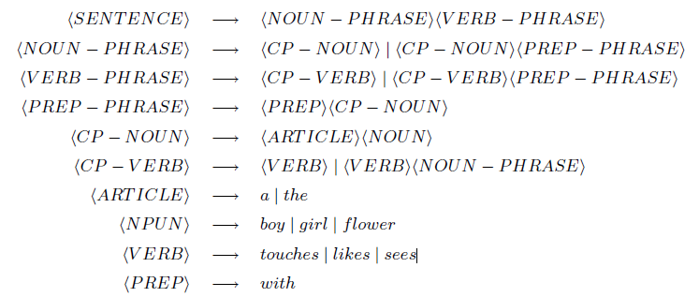
Another example G₂

Slide 9
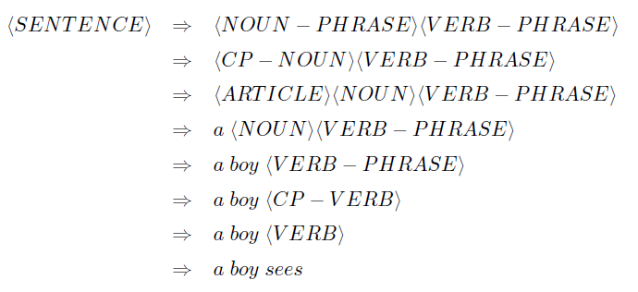
Derivation with G₂

Slide 10
Direct derivation
If u, v, w ∈ (V ∪ Σ) (i.e., are strings of variables and terminals) and A → w ∈ R (i.e., is a rule of the grammar) then we say that uAv yields uwv, written uAv ⇒ uwv
We may also say that uwv is directly derived from uAv using the rule A → w

Slide 11

Derivation
We write u v if u = v or if a sequence u₁, u₂, . . . , u_{k} ∈ (V ∪ Σ)* exists, for k ≥ 0, and u₁ ⇒ u₂ ⇒ . . . ⇒ u_{k} ⇒ v
We may also say that u₁, u₂, . . . , u_{k}, v is a derivation of v from u₁
For example, a boy sees is a derivation of <SENTENCE>

Slide 12
Language Specified by G
If G = (V, Σ, R, S) is a CFG then the language specified by G (or the language of G) is a CFL
L(G) = {w ∈ Σ* | S ⇒ w}

Slide 13
Yet another example G₃
Consider the grammar G₃ = ({S}, {a, b}, {S → aSb | SS | ε}, S)
L(G3) contains strings such as abab, aaabbb, aababb;
If one thinks of a as the left parenthesis ( and b as the right parenthesis), then we can see that L(G₃) is the language of all strings of properly nested parentheses abab → ()(), aaabbb → ((())), and aababb → (()())

Slide 14
Why CFG
Context-free grammars are used as basis for compiler design and implementation.
Context-free grammars are used as specification mechanisms for programming languages
Designers of compilers use such grammars to implement compiler’s components, such a scanners, parsers, and code generators
The implementation of almost any programming language is preceded by a context-free grammar that specifies it

Slide 15
Arithmetic Expressions
Consider the grammar G₄ = ({E, T, F}, {a,+, ∗, (, )},R,E) where R consists of:
E → E + T | T
T → T ∗ F | F
F → (E) | a
L(G₄) is the language of arithmetic expressions

Slide 16
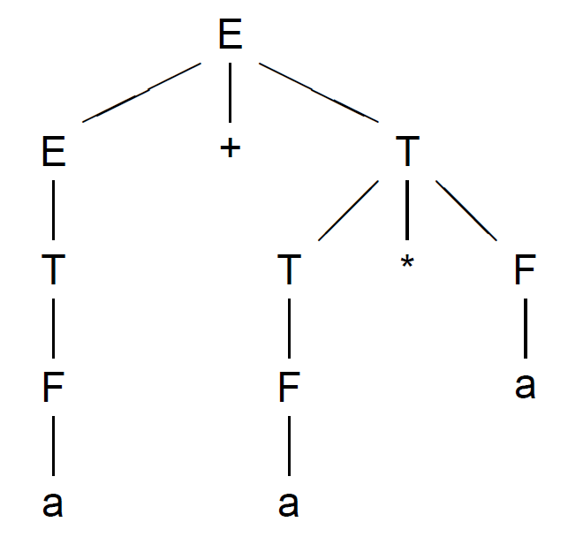
Example Derivation with G₄
For a + a * a we have

Slide 17
Designing CFGs
Interesting reading – we will not do it, except show a few examples

Slide 18
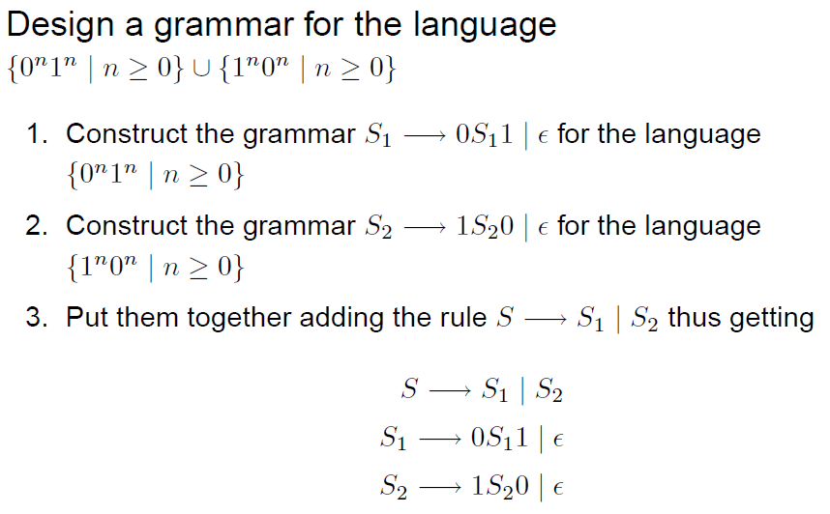
Example Grammar Design

Slide 19
Ambiguity
If a CFG generates the same string in several different ways, we say that the string is derived ambiguously in that grammar.
If a CFG generates some string ambiguously we say that the grammar is ambiguous.
Example: the grammar G₅, whose rules are:
E → E + E | E ∗ E | (E) | a
generate some arithmetic expressions ambiguously .

Slide 20
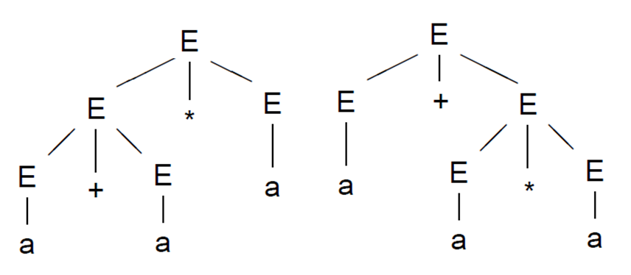
Ambiguity example
For a + a * a we may have two derivation trees

Slide 21
Comparing G₄ and G₅
The grammar G₅ does not capture the usual precedence relations and so groups the + before * and vice versa.
In contrast, the grammar G₄ generates the same language, but every generated string has a unique derivation tree.
Hence, G₅ is ambiguous and G₄ is not, i.e., G₄ is unambiguous.

Slide 22
Arithmetic Expressions
Consider the grammar G₄ = ({E, T, F}, {a,+, ∗, (, )},R,E) where R consists of:
E → E + T | T
T → T ∗ F | F
F → (E) | a
L(G₄) is the language of arithmetic expressions

Slide 23
Inherent Ambiguity
Some CFL can have both ambiguous and unambiguous grammars.
Some CFL, however, can be generated only by an ambiguous grammar.
A CFL that can be generated only by ambiguous grammars is called inherently ambiguous.
Example of inherently ambiguous language: {0^{i}1^{j}2^{k} | i = j ∨ j = k}

Slide 24
Chomsky Normal Form
It is often convenient to simplify CFG.
One of the simplest and most useful simplified forms of CFG is called the Chomsky normal form
A context-free grammar G is in Chomsky normal form if every rule is of the form:
A → BC
A → a
where a is a terminal, A,B,C are nonterminals, and B,C may not be the start variable.
Note: the rule S → ε, where S is the start variable, is not excluded.

Slide 25
Theorem 2.9
Any context-free language is generated by a context-free grammar in Chomsky normal form.
Proof idea:
Show that any grammar G can be converted into Chomsky normal form.
Conversion procedure has several stages where the rules that violate Chomsky normal form conditions are replaced with equivalent rules that satisfy these conditions.
Order of transformations:(1) add a new start variable, (2) eliminate all ε-rules, (3) eliminate unit-rules, (4) convert rules.
Check that the obtained grammar define the same language as the initial.

Slide 26
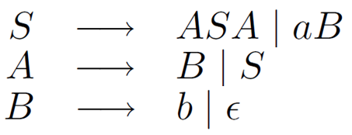
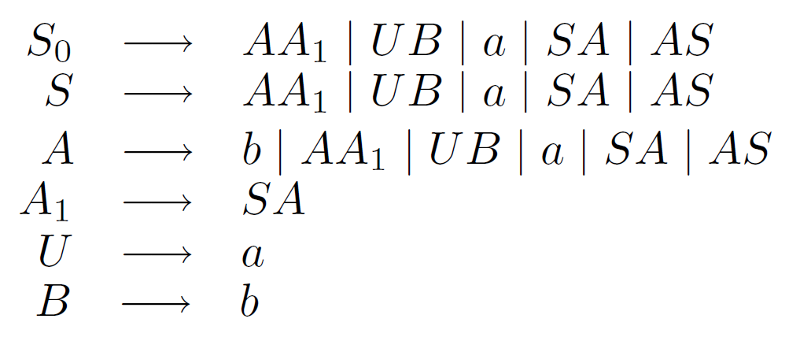
Example
Consider language

Slide 27
Language Classes
Violates Pumping Lemma
For CFLs
Scheme
0^{n}1^{n}2^{n}
0^{n}1^{n}
ww
Violates Pumping Lemma For RLs
0^{n}
Described by DFA, NFA, RegExp, RegGram
w
Described by LL(k) Grammar
Described by CFG, NDPDA
Regular Languages
Deterministic CFLs
LL(k) Languages
Java
Context-Free Languages
Python

Slide 28
Pushdown automata, PDA
Pushdown automata, PDA, are a new type of computation model
PDAs are like NFAs but have an extra component called a stack
The stack provides additional memory beyond the finite amount available in the control
The stack allows PDA to recognize some nonregular languages

Slide 29
PDA and CFG
PDA are equivalent in specification power with CFG
This is useful because it gives us two options for proving that a language is context-free:
1. construct a CFG that generates the language or
2. construct a PDA that recognizes the language

Slide 30
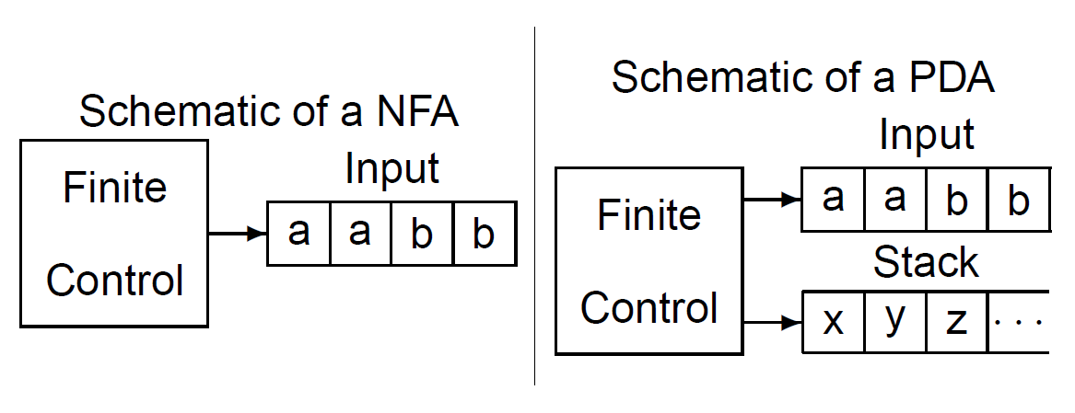
Schematic representation of a PDA

Slide 31
Stacks
Writing a symbol on the stack is referred to as pushing the symbol
Removing a symbol from the stack is referred to as popping the symbol
All access to the stack may be done only at the top
In other words: a stack is a “last-in first-out" storage device

Slide 32
Benefits of the stack
A stack can hold an unlimited amount of information
A PDA can recognize a language like {0^{n}1^{n} | n ≥ 0} because it can use the stack to remember the number of 0s it has seen
Informally :
1. Read symbols from the input. As each 0 is read push it onto the stack
2. As soon as a 1 is read, pop a 0 off the stack for each 1 read
3. If input finishes when stack becomes empty accept; if stack becomes empty while there is still input or input finishes while stack is not empty reject

Slide 33
Define PDA
A pushdown automaton is a 6-tuple (Q, Σ, Γ, δ, q₀, F) where
Q, Σ, Γ, and F are finite sets, and:
1. Q is a set of states
2. Σ is the input alphabet
3. Γ is the stack alphabet
4. δ : Q × Σ_{ε} × Γ _{ε} → P(Q × Γ _{ε}) is the transition function
5. q₀ ∈ Q is the start state
6. F ⊆ Q is the set of accept states

Slide 34
What are we saying
Formal definition of a PDA is similar to a NFA, except the stack
PDA may use different alphabets for input and stack, we will denote them by Σ and Γ
Nondeterminism allows PDA to make transitions on empty input. Hence we will use Σ_{ε} = Σ ∪ {ε} and Γ_{ε}= Γ ∪ {ε}
Domain of the PDA transition function is Q × Σ_{ε} × Γ_{ε} where Q is the
set of states
Since a PDA can write on the stack while performing nondeterministic transitions the range of the PDA transition function is P(Q × Γ_{ε})
In conclusion: δ : Q × Σ_{ε} × Γ_{ε} → P(Q × Γ_{ε})

Slide 35
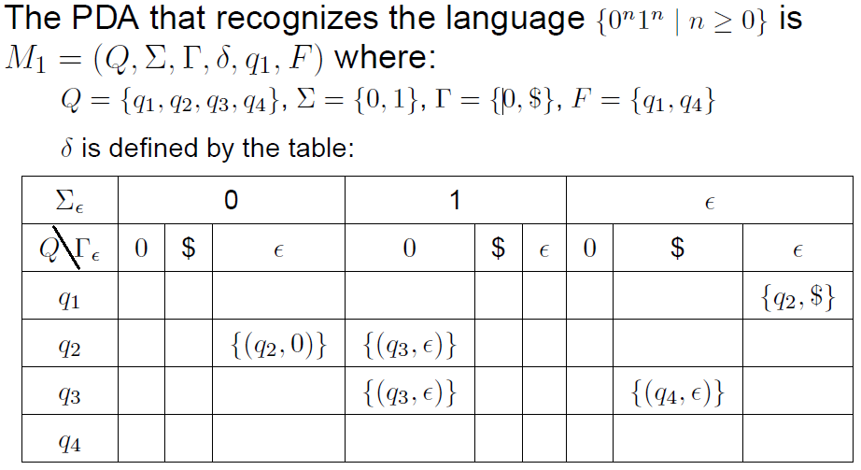
PDA for {0^{n}1^{n}| n>= 0}
{(q₂,0)} saying the new state is q₂ and the top of the stack is 0

Slide 36
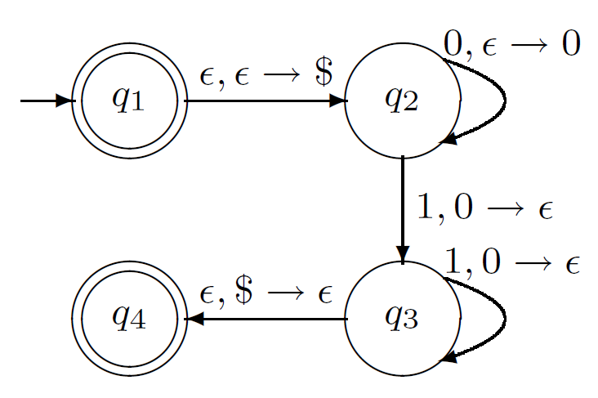
The State Diagram of PDA
a, b → c is saying reading a and top of the stack is b, then replace it (the top of the stack) with an c

Slide 37
Example 2.16
This example provides the PDA M₂ that recognizes the language {a^{i}b^{j}c^{k} | i, j, k ≥ 0 ∧ i = j ∨ i = k}
Informal description:
The PDA first reads and push a’s on the stack
When this is done, it can match with b’s or c’s
Since machine does not know in advance whether a’s are matched with b’s or c’s, nondeterminism helps
Using nondeterminism the machine can guess: the machine has two branches, one for each possible guess
If either of these branches terminates, it accept the input

Slide 38
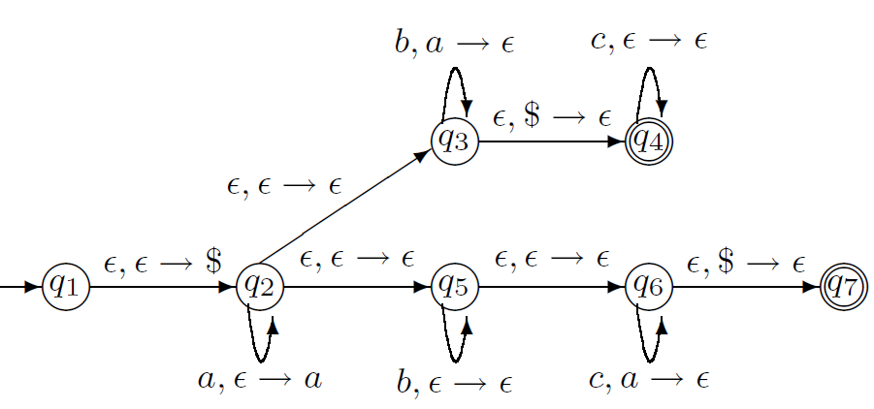
State Diagram of M₂

Slide 39
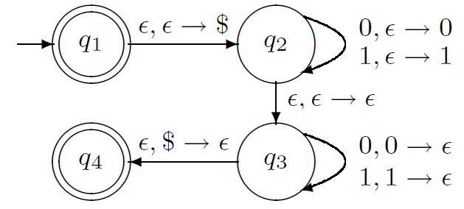
Example 2.18
This example provides the PDA M₃ that recognizes the language {ww^{R} | w ∈ {0, 1}}. Recall that w^{R} means w written backwards.

Slide 40
CFG = PDA
Theorem 2.20
A language is context free if and only if some pushdown automaton recognizes it
Lemma 2.21
If a language is context free, then some pushdown automaton recognizes it
Lemma 2.22
If a pushdown automaton recognizes some language, then it is context free
Corollary 2.32
Every regular language is context free

Slide 41
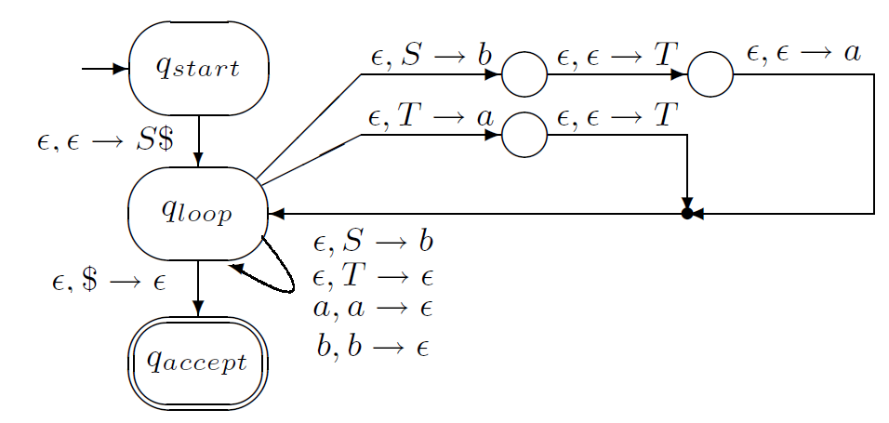
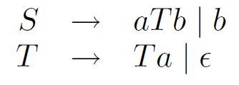
Lemma 2.1 example

Slide 42
CFG – Pumping Lemma – informal
Pumping lemma for context-free languages states that every CFL has a specific value called pumping length such that all longer strings in the language can be pumped
However, the meaning of pumping is a bit more complex than in case of regular languages
Here pumping means that a string can be divided into five parts so that the second and fourth parts may be repeated any number of times and the resulting string is in the language

Slide 43
CFG – Pumping Lemma
Theorem 2.34: If A is a context-free language, then there is a number p (the pumping length) where, if s ∈ A and |s| ≥ p, then s may be divided into five pieces, s = uvxyz satisfying the conditions:
1. For each i ≥ 0, uv^{i}xy^{i}z ∈ A
2. |vy| ≥ 0
3. |vxy| ≤ p

Slide 44
CFG – Pumping Lemma
Think in the case of a + a, or 0^{n}1^{n}.
That is, if we have a rule A → 0A1, then we can keep applying the rule to pump 0’s and 1’s

Slide 45
Example 2.36
Use pumping lemma to show that the language B = {a^{n}b^{n}c^{n} | n ≥ 0} is not context-free
Proof: assume that B is context-free to obtain a contradiction
Let p be the pumping length for B that is guaranteed to exists by pumping lemma
Consider the string s = a^{p}b^{p}c^{p} ∈ B of length at least p
The pumping lemma states that s can be pumped and here we show that it cannot be pumped
I.e, we will show that no matter how we divide s into uvxyz one of the three conditions of the pumping lemma is violated

Slide 46
Proof-
Condition 2 stipulates that either v or y is not empty.
1. When both v and y contain only one type of symbols (a,b,c) v does not contain both a’s and b’s or both b’s and c’s; the same hold for y. In this case uv²xy²z cannot contain equal number of a’s, b’s and c’s., hence it cannot be in B which violates condition 1 of the lemma
2. When either v of y contain more than one type of symbols (a,b,c) uv²xy²z may contain equal numbers of a’s, b’s, c’s but they don’t come in the right order. Hence, it cannot be in B either
One of these cases must occur. Because both cases result in contradiction, a contradiction is unavoidable so the assumption B is a CFL must be false

Slide 47
Example 2.37
Use pumping lemma to show that C = {a^{i}b^{j}c^{k} | 0 ≤ i ≤ j ≤ k} is not a context-free language
Proof: assume that C is CFL and obtain a contradiction. Let p be the pumping length and s = a^{p}b^{p}c^{p}. We will try to pump it down and pump up.
Let s = uvxyz and again consider two cases
1. Both v and y contain only one of the symbols a,b,c
2. Either v or y contain more than one of symbols a,b,c

Slide 48
Proof with Case 1
Because v or y contains one symbol, one of the symbols a, b, or c does not appear in v or y.
1. The a’s do not appear in v and y. Consider the string uv⁰xy⁰z = uxz which contains the same number of a’s as s but it contain fewer b’s or fewer c’s. Therefore uxz is not a member of C.
2. The b’s do not appear in v and y. Since not both v and y may be empty strings, a’s or c’s must appear in v or y. If a’s appear the string uv²xy²z contains more a’s than b’s so it is not in C; if c’s appear, the string uv⁰xy⁰z contains more b’s than c’s so it is not in C. Either way we obtain a contradiction
3. The c’s do not appear. Then uv²xy²z contains more a’s or b’s than c’s so it is not in C, and a contradiction occurs.

Slide 49
When either v or y contain more than one of a, b, c, then uv²xy²z will not contain the symbols a, b, c in the correct order. Hence it cannot be a member of C and a contradiction occurs.
Conclusion : s cannot be pumped in violation of pumping lemma and C is not a CFL.

Slide 50
Example 2.38
Use pumping lemma to show that D = {ww | w ∈ {0, 1}} is not a CFL
Proof: assume that D is CFL and obtain a contradiction. Let p be the pumping length given by pumping lemma. However, the choosing of s is less obvious
1. Try s = 0^{p}10^{p}1. But we may chose: u = ^{0p−1}, v = 0, x = 1, y = 0, z = 0^{p−1}1 and we can see that it can be pumped.
2. Another candidate is s = 0^{p}1^{p}0^{p}1^{p}. We shows that this string cannot be pumped using condition 3 of the pumping lemma.

Slide 51
Assume that s can be pumped and set s = uvxyz where |vxy| ≤ p.
String vxy must contain the midpoint of s. If vxy would occur only in the first half of s, pumping uv2xy2z moves a 1 into the first position of the second half and so it cannot be of the form ww.
Similarly if vxy is in the second part of s. pumping uv²xy²z moves a 0 into the last position of the first half of s so it cannot be of the form ww.
If vxz contains the midpoint of s, when we pump s down to uxz, it has the form 0p1i0j1p where i and j cannot be both p. Hence this string is not of the form ww either.
Hence, s cannot be pumped and D is not a CFL

